Slide 1

Ministry of Electronics and Information Technology (MeitY)
Early Warning System for Flood Prediction in the River Basins of India
Partner Institute
Punjab Engineering College, Chandigarh

Slide 2
RESULTS OF SINGLE RESERVOIR OPERATION USING NSGA II,NSGA III AND EpsMOEA

Slide 3
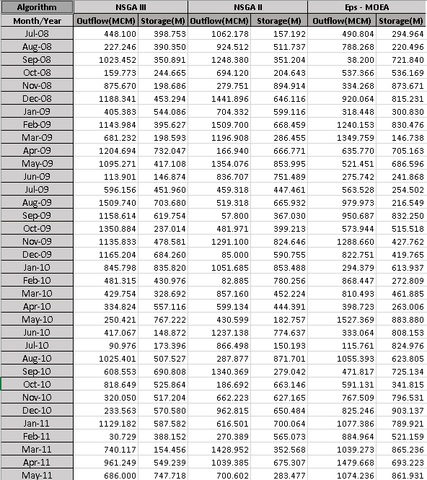
Final Output Ravishankar Data

Slide 4
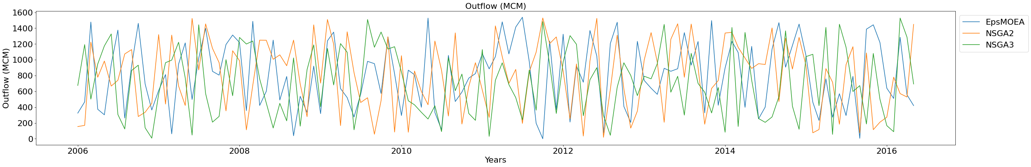
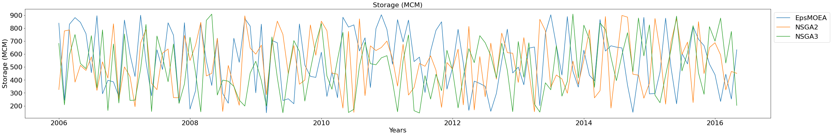
COMPARISONS OF THE RESULTS OF THREE ALGORITHMS AS FOLLOWS:

Slide 5
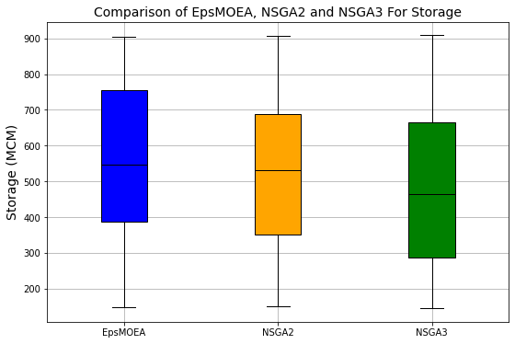
Analysis of Results (For Storage)
Algorithms | NSGA-II | Eps-MOEA | NSGA-III
Standard Deviation | 209.47 | 220.37 | 218.16
Median | 532.52 | 547.10 | 464.44
Minimum | 149.30 | 146.73 | 145.13
Maximum | 908.06 | 905.03 | 908.54
Based on the Evaluation parameter viz. lowest Standard Deviation, Minimum storage, comparable value (Median and Maximum storage). It can be concluded that the algorithm NSGA-II performed well as per formulated single objective function for flood control.
Notes:
From the box plot, it can be seen that the optimized NSGA-II seems to perform the best in our use case, having lowest standard deviation, lower Minimum storage and negligible difference of 2 Meters in maximum storage. Of course, this analysis result will vary when applied on different dataset and/or with different objective functions

Slide 6
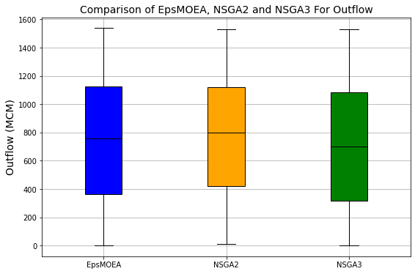
Analysis of Results (For Outflow)
Algorithms | Eps-MOEA | NSGA-II | NSGA-III
Standard Deviation | 444.90 | 428.10 | 435.84
Median | 757.20 | 797.93 | 698.98
Minimum | 0.69 | 11.33 | 0.98
Maximum | 1537.82 | 1530.41 | 1531.12
Notes:
From the box plot, it can be seen that the optimized NSGA-II seems to perform the best in our use case, having lowest standard deviation, lower Minimum storage and negligible difference of 2 Meters in maximum storage. Of course, this analysis result will vary when applied on different dataset and/or with different objective functions

